Slide 1



ZENLISH – HỌC TOEIC 1 LẦN LÀ ĐẠT
BEGINNER’S TOEIC
LESSON 6

Slide 2



ZENLISH – HỌC TOEIC 1 LẦN LÀ ĐẠT
BEGINNER’S TOEIC
LESSON 6
PART 2: LUYỆN ĐỀ TỔNG HỢP

Slide 3

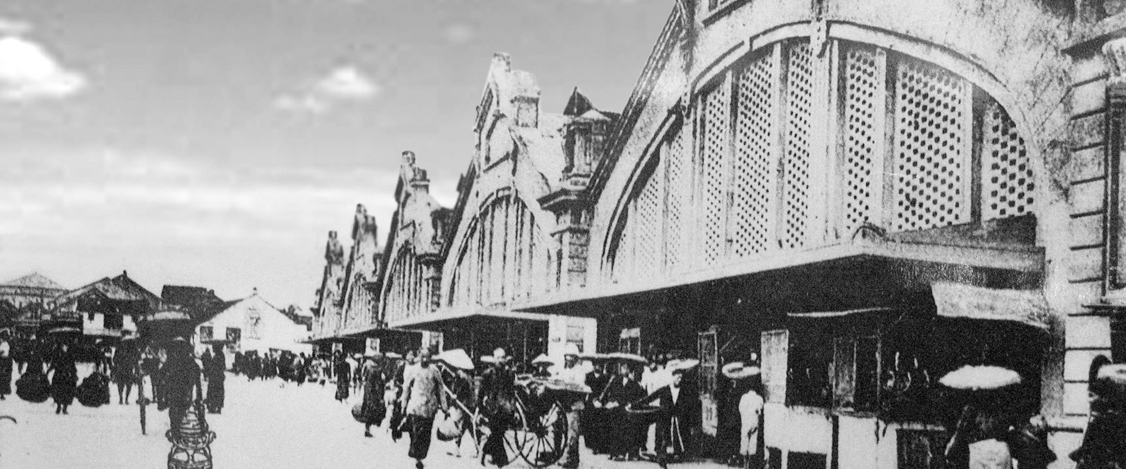
01
ZENLISH – HỌC TOEIC 1 LẦN LÀ ĐẠT

Slide 4
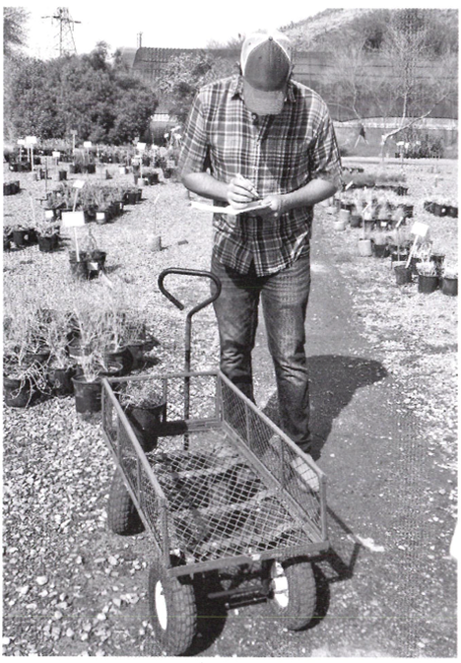


01

Slide 5
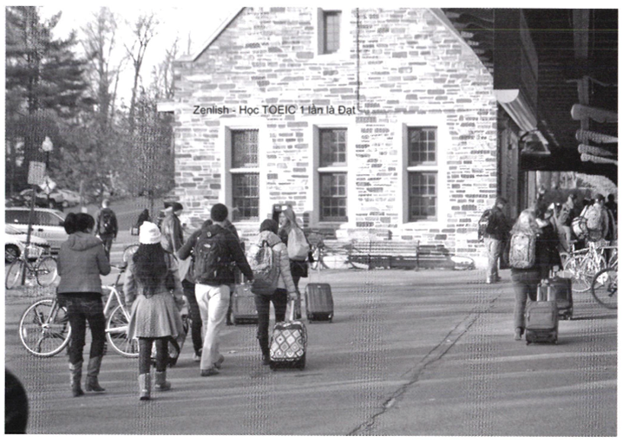
02

Slide 6
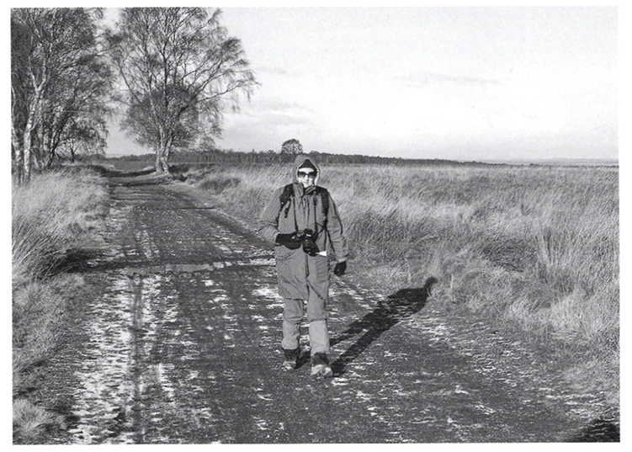
03

Slide 7
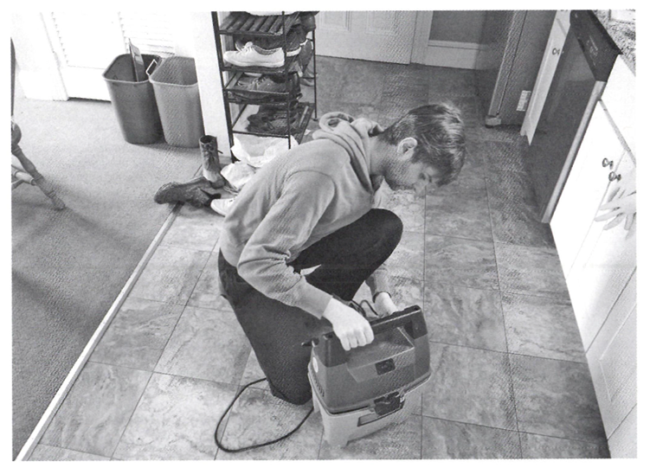
04

Slide 8
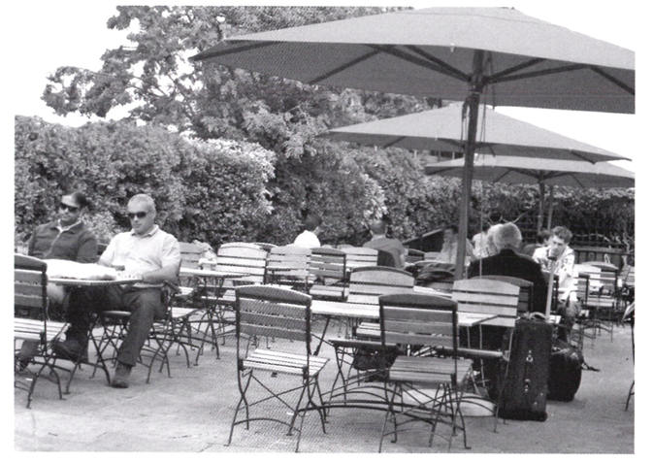
05

Slide 9
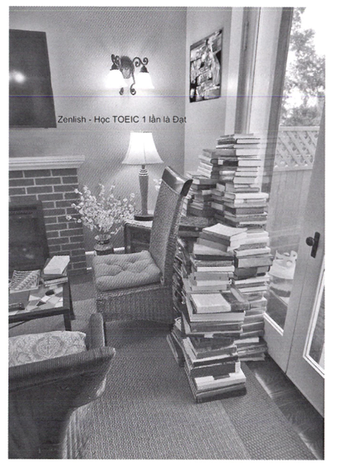
06

Slide 10

PART 1
Tapescript & Anwser Key
1-B 4-A
2-C 5-B
3-A 6-D

Slide 11
01
(A) The worker is carrying some plants.
(B) The worker is reading a sign.
(C) The worker is pushing a cart.
(D) The worker is writing some notes.

Slide 12
02
(A) Some of the people are pulling suitcases.
(B) Some of the people are relaxing on benches.
(C) Some of the people are putting luggage onto a rack.
(D) Some of the people are waiting in line to purchase a ticket.

Slide 13
03
(A) She’s looking into her backpack.
(B) She’s tying the laces of her boots.
(C) She’s hiking on an outdoor path.
(D) She's walking out of a tunnel.

Slide 14
04
(A) He’s holding the handle of a shopping cart.
(B) He’s plugging a cord into a wall outlet.
(C) He’s looking into a kitchen cupboard.
(D) He’s kneeling down on a file floor.

Slide 15
05
(A) Seats have been arranged under some umbrellas.
(B) Some street signs are being taken down.
(C) Some bushes are being trimmed.
(D) Some chairs are being folded and stacked.

Slide 16
06
(A) Some cushions have been laid on the floor.
(B) Books have been piled up by a glass door.
(C) A light fixture is suspended from the ceiling.
(D) A rug has been rolled up against a wall.

Slide 17
02
ZENLISH – HỌC TOEIC 1 LẦN LÀ ĐẠT

Slide 18
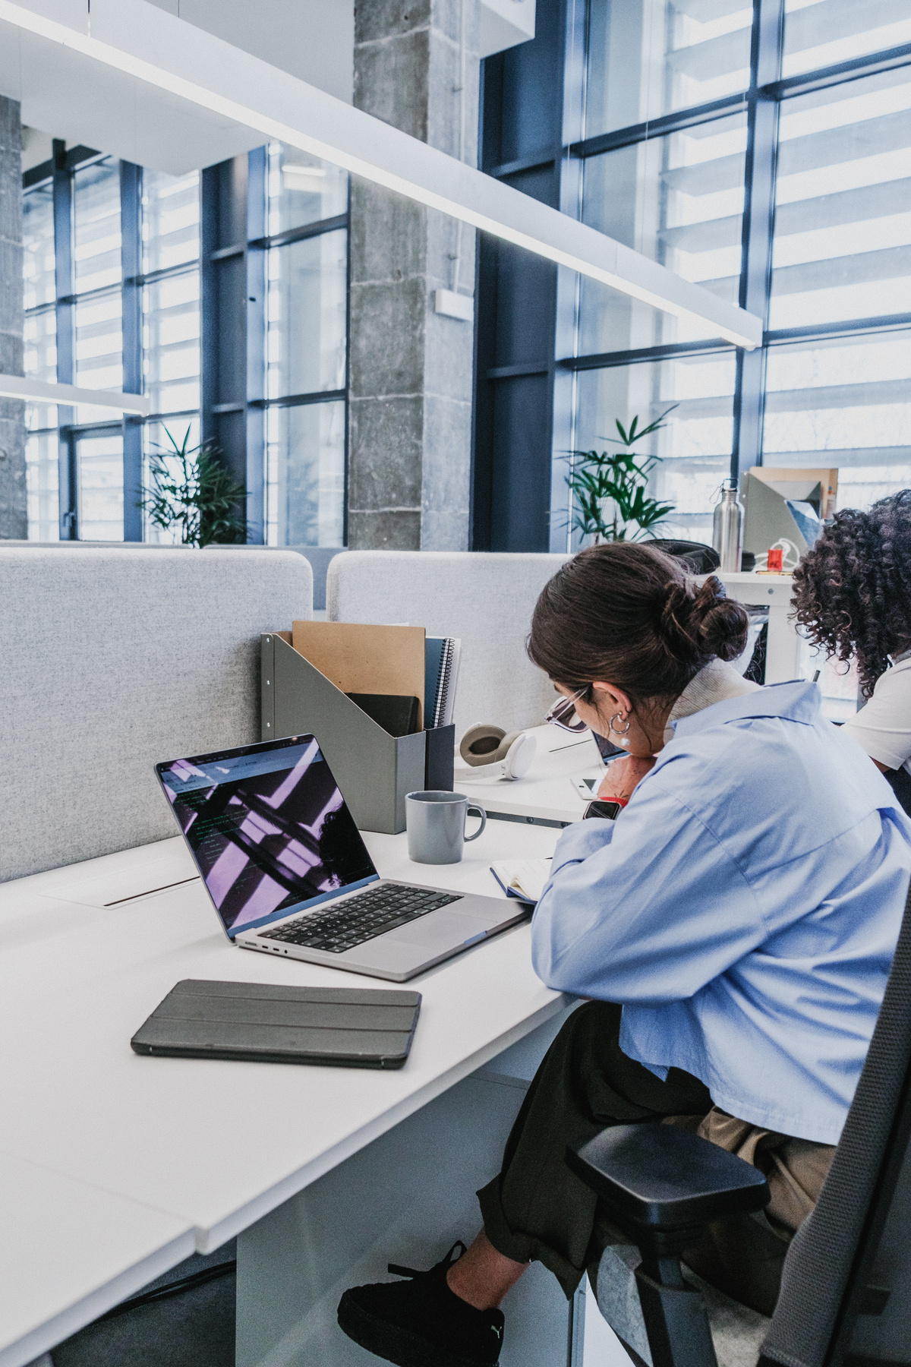
7
There’s a meeting in the conference room soon, right?
There’s a meeting in the conference room soon, right?
A. Yes. It’s for the whole department.
B. No, put it in the closet.
C. The rent is too high.

Slide 19
8
Why hasn’t the mural in the lobby been painted yet?
Why hasn’t the mural in the lobby been painted yet?
A. Red and yellow.
B. Please pick up the ladder.
C. Because the artist is out of town.

Slide 20
9
Do you prefer writing in the morning or the afternoon?
Do you prefer writing in the morning or the afternoon?
A. My publisher requested edits.
B. Thanks for providing a solution.
C. Mornings are usually better for me.

Slide 21
10
I suggest we paint the waiting room light blue.
I suggest we paint the waiting room light blue.
A. Doctor Park has an opening at three.
B. That’s a good idea.
C. I prefer the red jacket.

Slide 22
11
Did you know that the music school is closed on Sundays?
Did you know that the music school is closed on Sundays?
A. Forty dollars an hour.
B. No, I didn’t know that.
C. I saw the piano recital.

Slide 23
12
How do I find the office manager?
How do I find the office manager?
A. The receptionist would know.
B. Desk lamps and headsets.
C. Twelve euros.

Slide 24
13
When did you place the order for the lumber?
When did you place the order for the lumber?
A. Yes. it’s a great place for hiking.
B. It's out of stock right now.
C. The warehouse on William Street.

Slide 25
14
Where is the new packaging machine?
Where is the new packaging machine?
A. Ten packages a minute.
B. We met last Thursday.
C. We decided to keep the old one.

Slide 26
15
I’ll be out of the office this afternoon.
I’ll be out of the office this afternoon.
A. An awfully long commute.
B. OK — I’ll update your schedule.
C. It’s right down the hallway.

Slide 27
16
Are you taking a vacation once this project is over?
Are you taking a vacation once this project is over?
A. Yes – I’m planning a trip to Barcelona.
B. This is your second time, isn’t it?
C. Blueprints for a high-rise building.

Slide 28
17
Let’s post the sales report to our team’s Web page.
Let’s post the sales report to our team’s Web page.
A. We’re sharing a taxi to the airport.
B. I can do that.
C. A recent hiring decision.

Slide 29
18
Which airline are you planning on using?
Which airline are you planning on using?
A. The usual one.
B. A one-way ticket.
C. Yes, you can use mine.

Slide 30
19
Where’s this shipment of parts being sent?
Where’s this shipment of parts being sent?
A. Around five thirty this evening.
B. To the assembly plant in Dublin.
C. Just half the order.

Slide 31
20
Who paid for lunch?
Who paid for lunch?
A. I just ate.
B. It closes at five.
C. Alberto did.

Slide 32
21
How many employees work in your department?
How many employees work in your department?
A. I don't mind taking notes at the meeting.
B. A couple dozen, I think.
C. It’s seven meters long.

Slide 33
22
We should leave for our training course soon, shouldn’t we?
We should leave for our training course soon, shouldn’t we?
A. We still have a few minutes.
B. There’s a map on the wall.
C. Two sessions per day.

Slide 34
23
Isn't there a limit on travel expenses?
Isn't there a limit on travel expenses?
A. To fix the vending machine.
B. One hundred dollars per day.
C. Next to the travel agency.

Slide 35
24
When should I tell the director that I’m interested in the management position?
When should I tell the director that I’m interested in the management position?
A. Yes, we’re extending our business hours.
B. Didn’t Andrey direct the play?
C. I’m not on the hiring team.

Slide 36
25
The layout of the footwear department has changed.
The layout of the footwear department has changed.
A. There’s a charging station in the cafe.
B. Yes, a three-bedroom apartment.
C. The store has a new manager.

Slide 37
26
Can you look at this month’s revenue report?
Can you look at this month’s revenue report?
A. The news program is informative.
B. I have some free time tomorrow afternoon.
CHe started that position in July.

Slide 38
27
Why haven’t the windows been replaced yet?
Why haven’t the windows been replaced yet?
A. Not too much wind, no.
B. Look in the filing cabinet.
C. Did you see the cost estimate?

Slide 39
28
Isn’t your suitcase going to be heavier than the permitted weight?
Isn’t your suitcase going to be heavier than the permitted weight?
A. The building permit arrived today.
B. There are seats in the lobby.
C. I’ll have to pay a little bit extra.

Slide 40
29
Who manufactures the engines for our machines?
Who manufactures the engines for our machines?
A. Koji is in charge of supplier contracts.
B. I’m sorry—the storage room is full.
C. That’s a cargo airplane.

Slide 41
30
Should we meet at the department store on Fifth Street or the one on Grover Lane?
Should we meet at the department store on Fifth Street or the one on Grover Lane?
A. Let’s ask Patricia first.
B. No, I don’t mind.
C. How much does it cost?

Slide 42
31
Which band is playing at the club tonight?
Which band is playing at the club tonight?
A. There’s always a comedy show on Thursday night.
B. Yes, I’ve played the piano for many years.
C. Their number one hit.

Slide 43
THANK YOU

